Slide 1
Tavern Keeper
Kaleb Scott, Silas Elder, Kenneth Gray, Evan Primasing

Slide 2
Overview
Purpose of Tavern Keeper
Technologies that we utilized
Details about our design and our design process
Steps for installation
Problems that we ran into along the way
Issues that we were not able to fix

Slide 3
Purpose
The purpose of Tavern Keeper is to allow authors, creators, and game masters to efficiently store and access all of their data
Tavern Keeper will allow these people to have the website pulled up as they are creating stories or playing games and easily find details about a certain character, map, location, or event

Slide 4
Technologies
Frontend: React
We used React due to it being widely popular in the job market today as well as having some prior experience in using React.
Backend: Node.js
Utilizing node.js as our backend allowed us to seamlessly communicate between our database and our frontend.
Server: Vercel
Vercel was an easy pick as documentation showed that integration between our React frontend and Node.js backend would be seamless.
Database: Supabase
Supabase is efficiently connected to Vercel out of the box, so integrating it into our system was extremely easy.

Slide 5
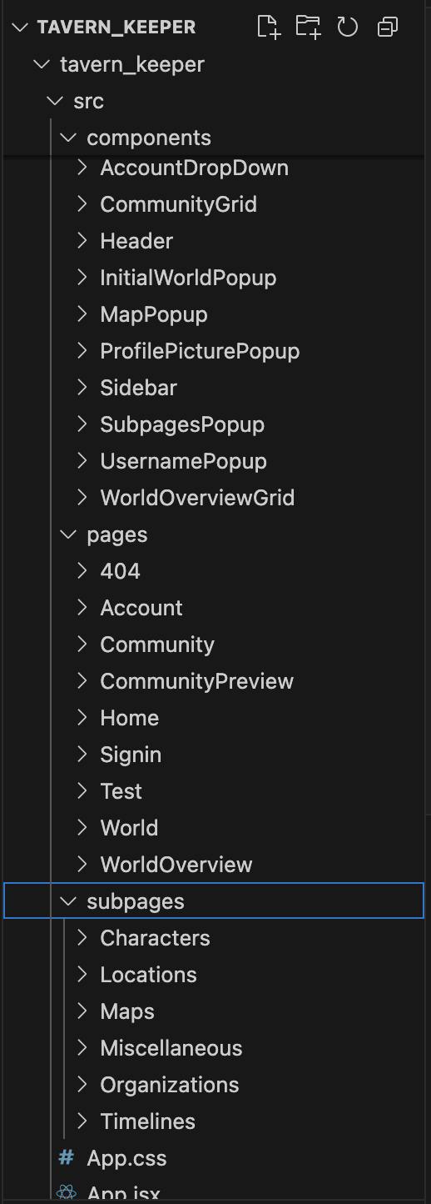
Component Design
React components - 3 categories:
Pages: large component, corresponds to a page on Tavern Keeper
Subpages: moderate sized component, corresponds to data entry category
Component: small sized component, pop ups, larger UI components too small to be its own page
Also - App (routing) & Index (rendering)

Slide 6
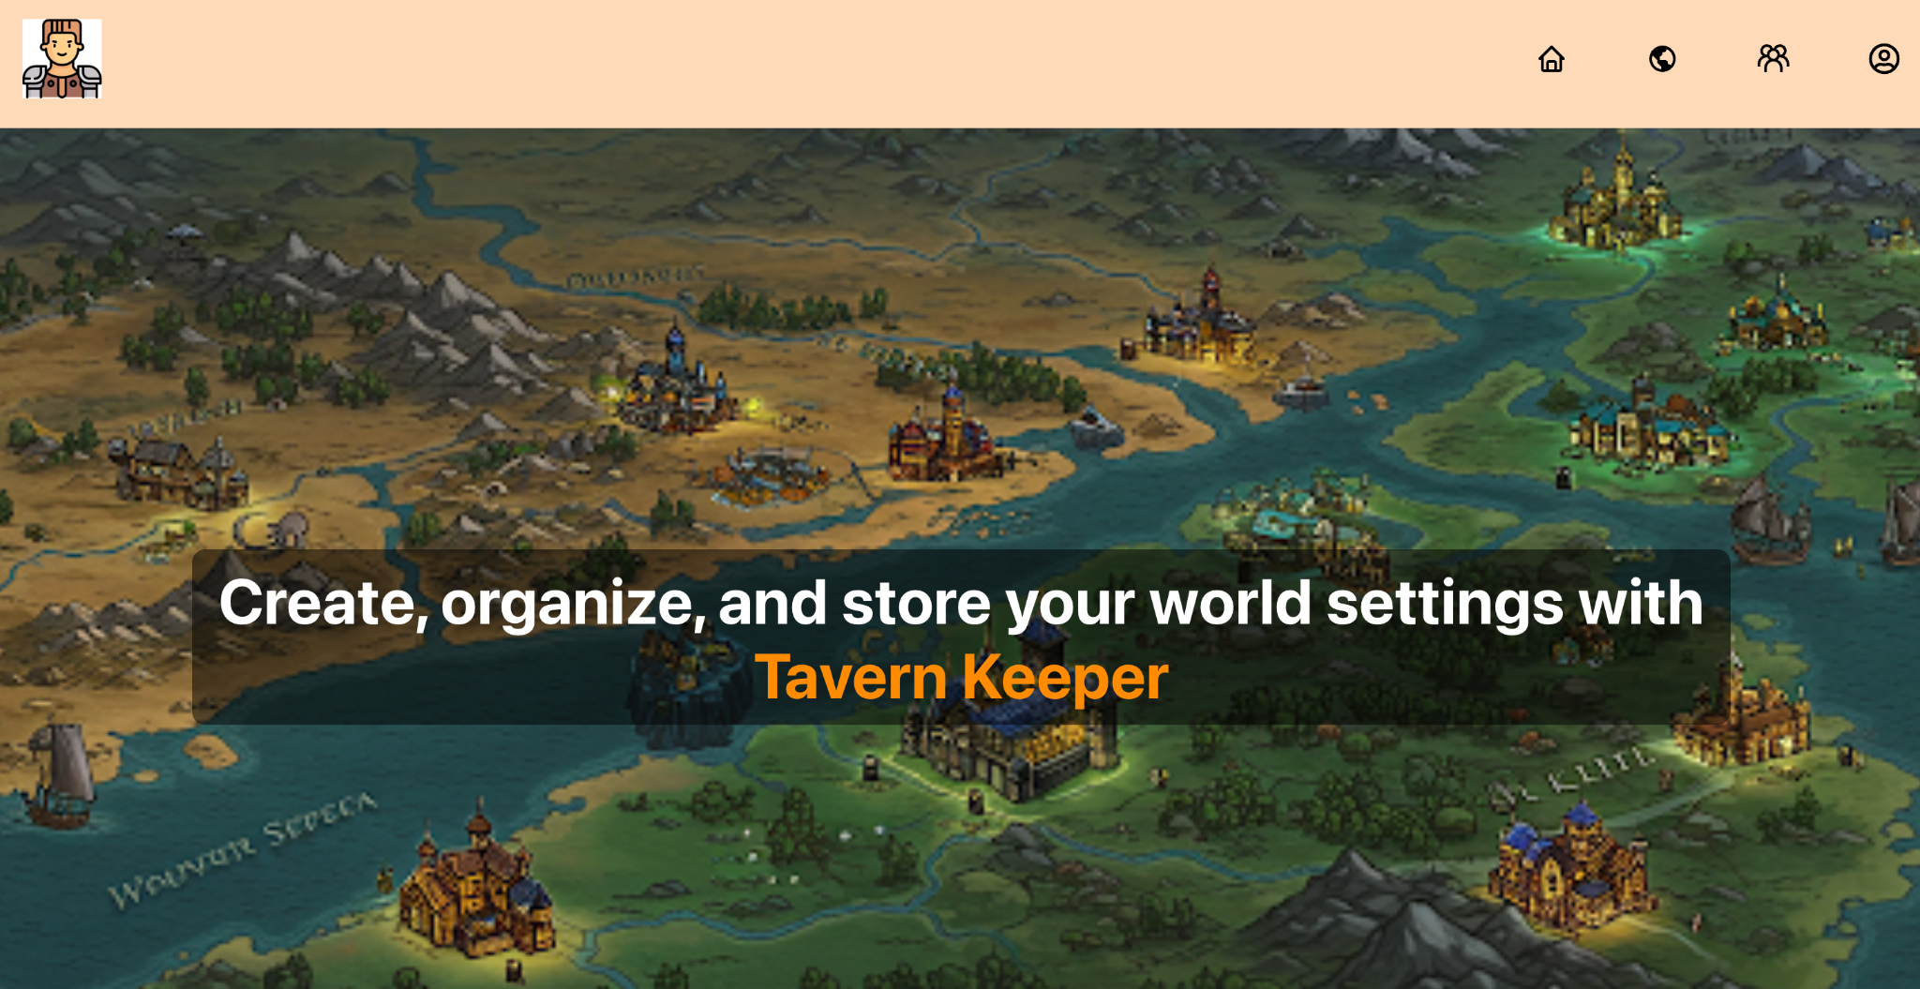
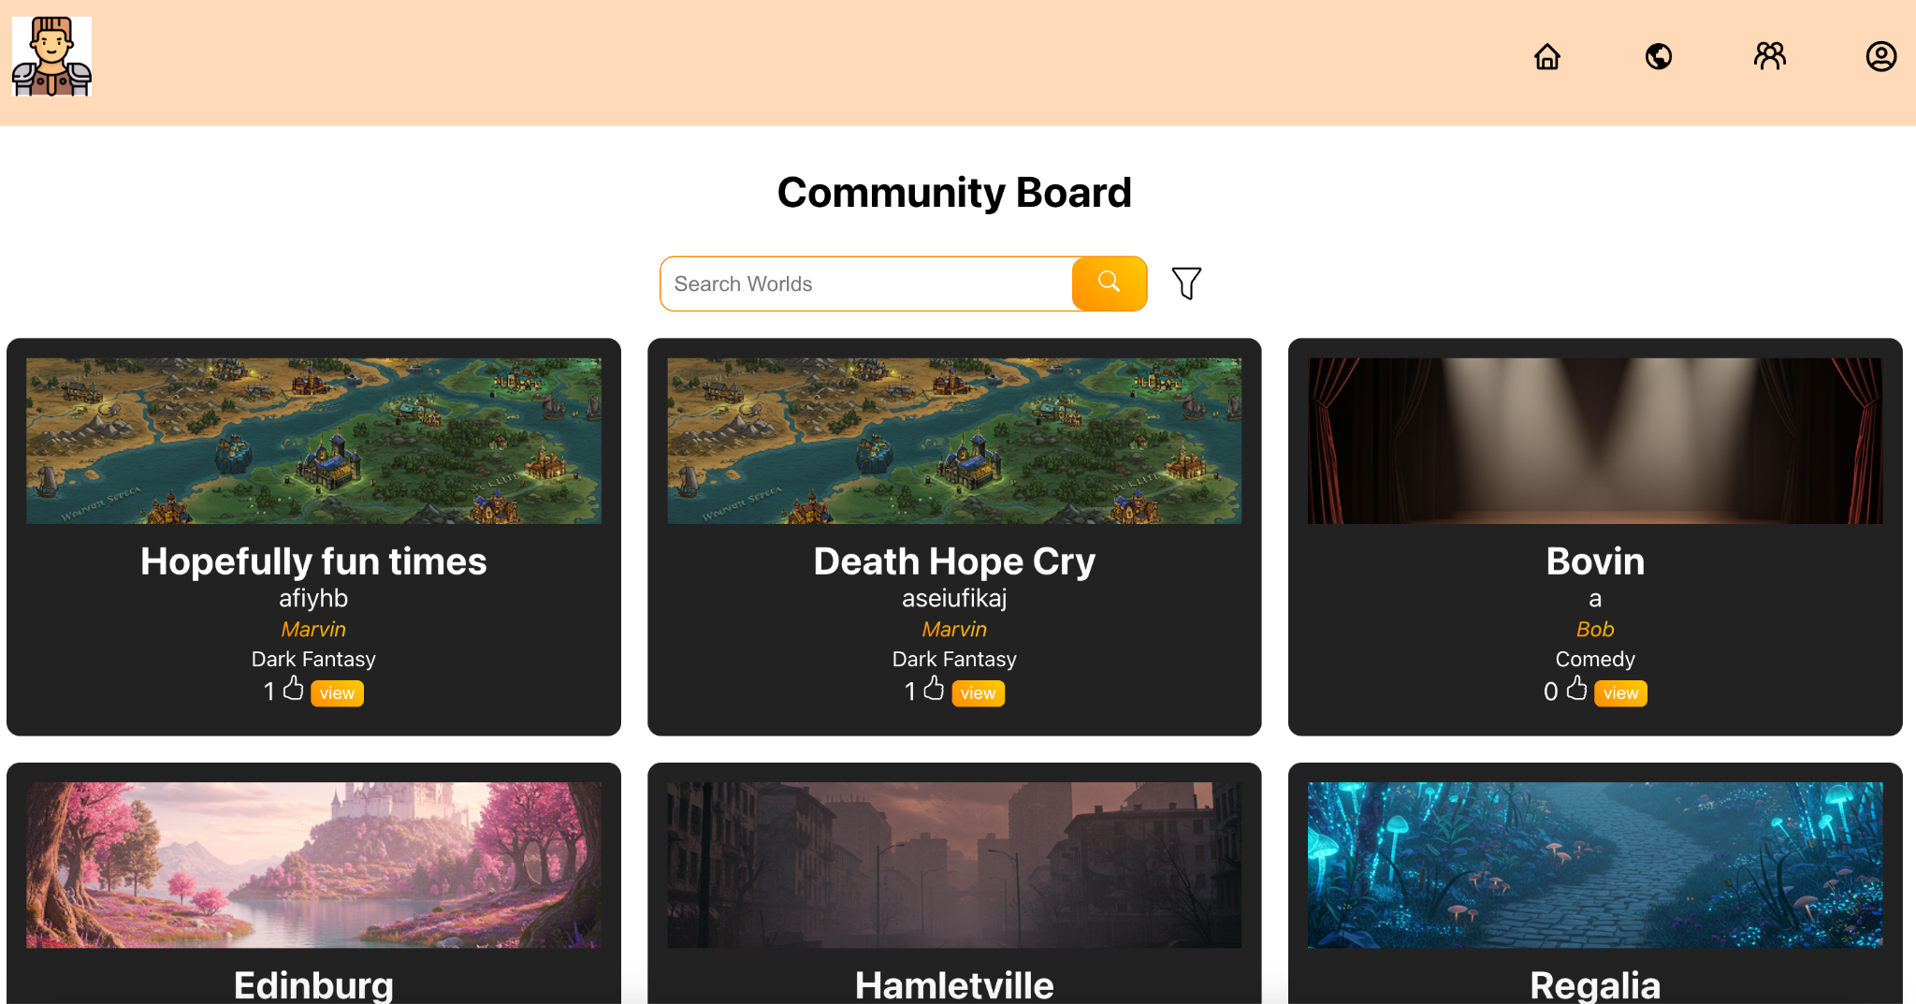
User Interface Design
No major delineation from initial design
Simple, compact
Image assets – free, open source, or AI generated (Gemini Flash 2.0)

Slide 7
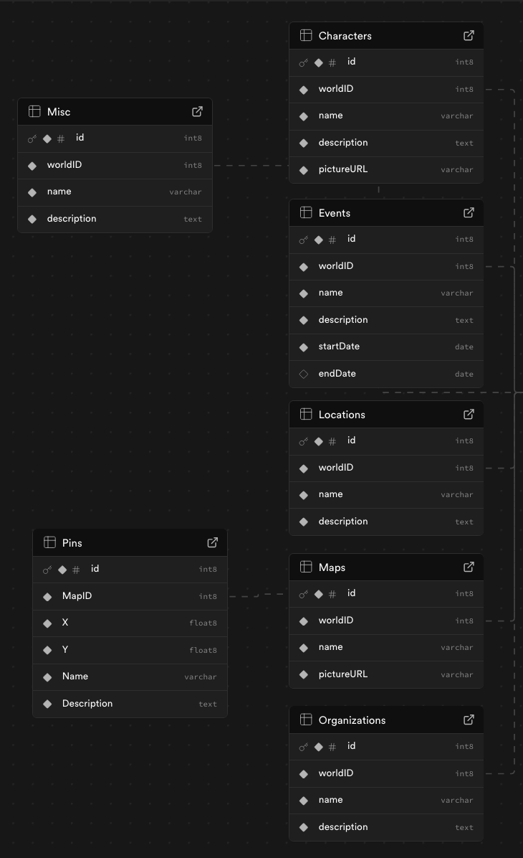
Backend Design
Supabase KEY and URL setup
Database statements – minimal SQL, calls could be written in JS once setup
Image Buckets – stores using a URL, fulfilled all image storage needs

Slide 8
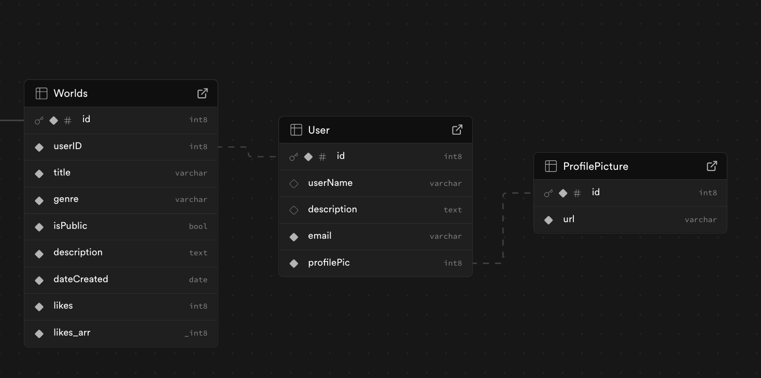
Backend Design cont.
Most tables are based on data entry categories
Character, Map, Location, etc.
The rest are worlds and broad user data
Username, desc, email
Process for creating database and tables was mostly visual on Supabase
Functions and triggers can also be stored on Supabase

Slide 9
Server Design
Vercel linked with Github repository – instant deployment once changes were made
Vercel analytics (user activity) and Security (vercell firewall)

Slide 10
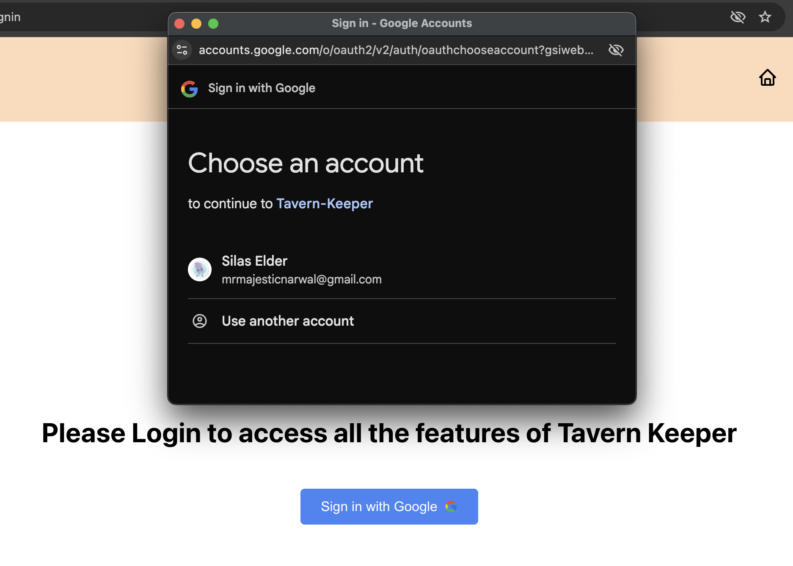
Login Design
GoogleOAuth plugin in our Index.js file
Can then authenticate user login – returns gmail to be stored in Supabase
When a new gmail is stored, a user record is created
By default a random username is generated

Slide 11
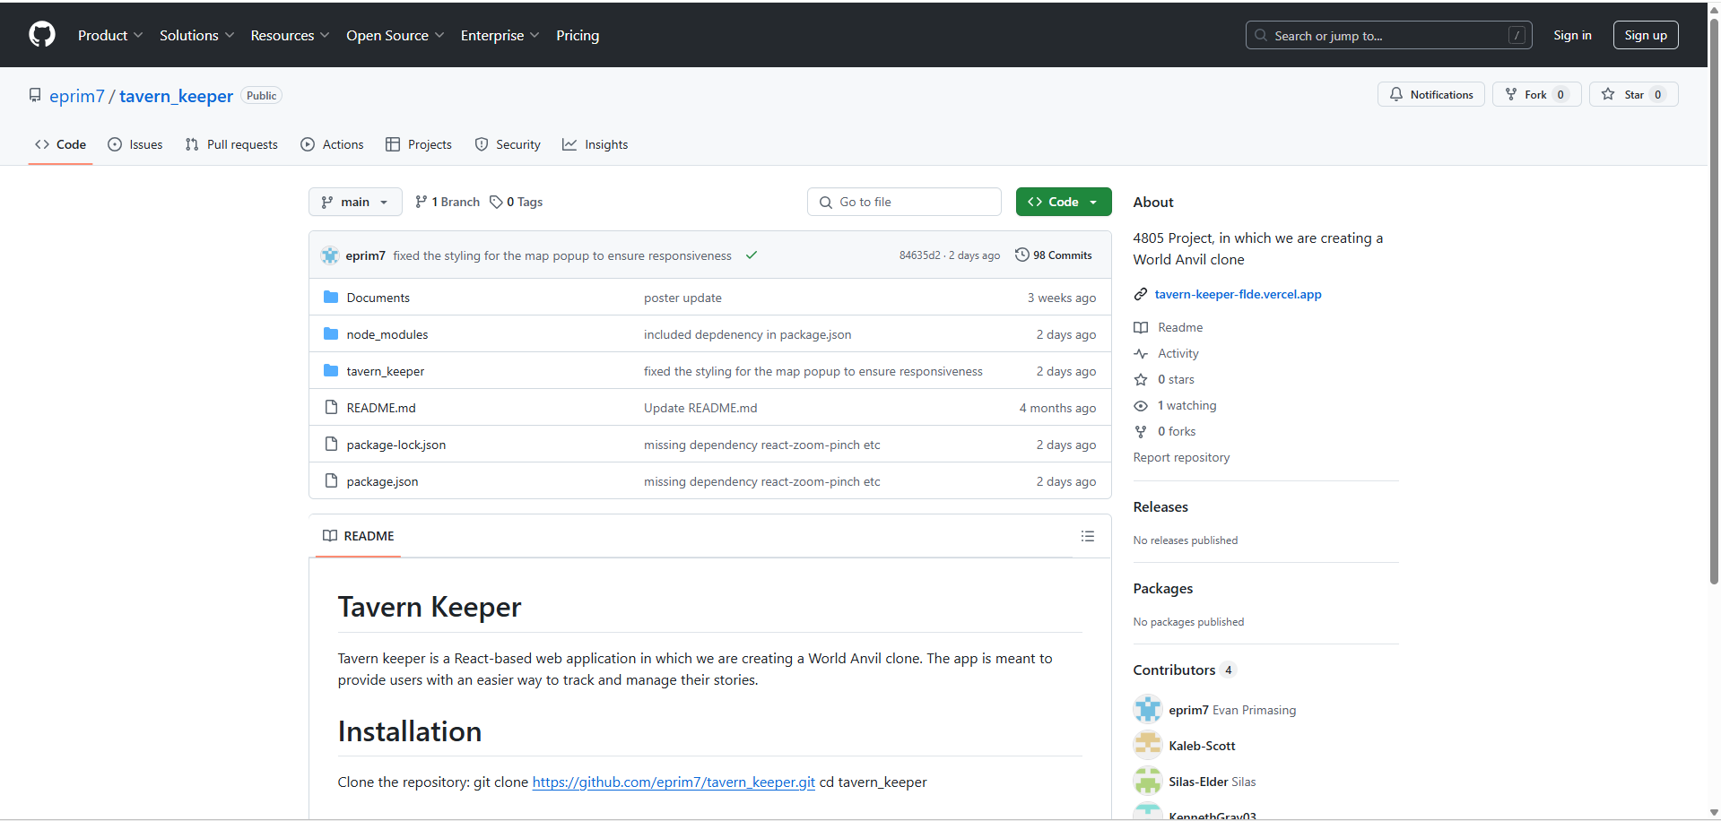
Copying Code from Github
Navigate to https://github.com/eprim7/tavern_keeper.git and click on the green code button

Slide 12
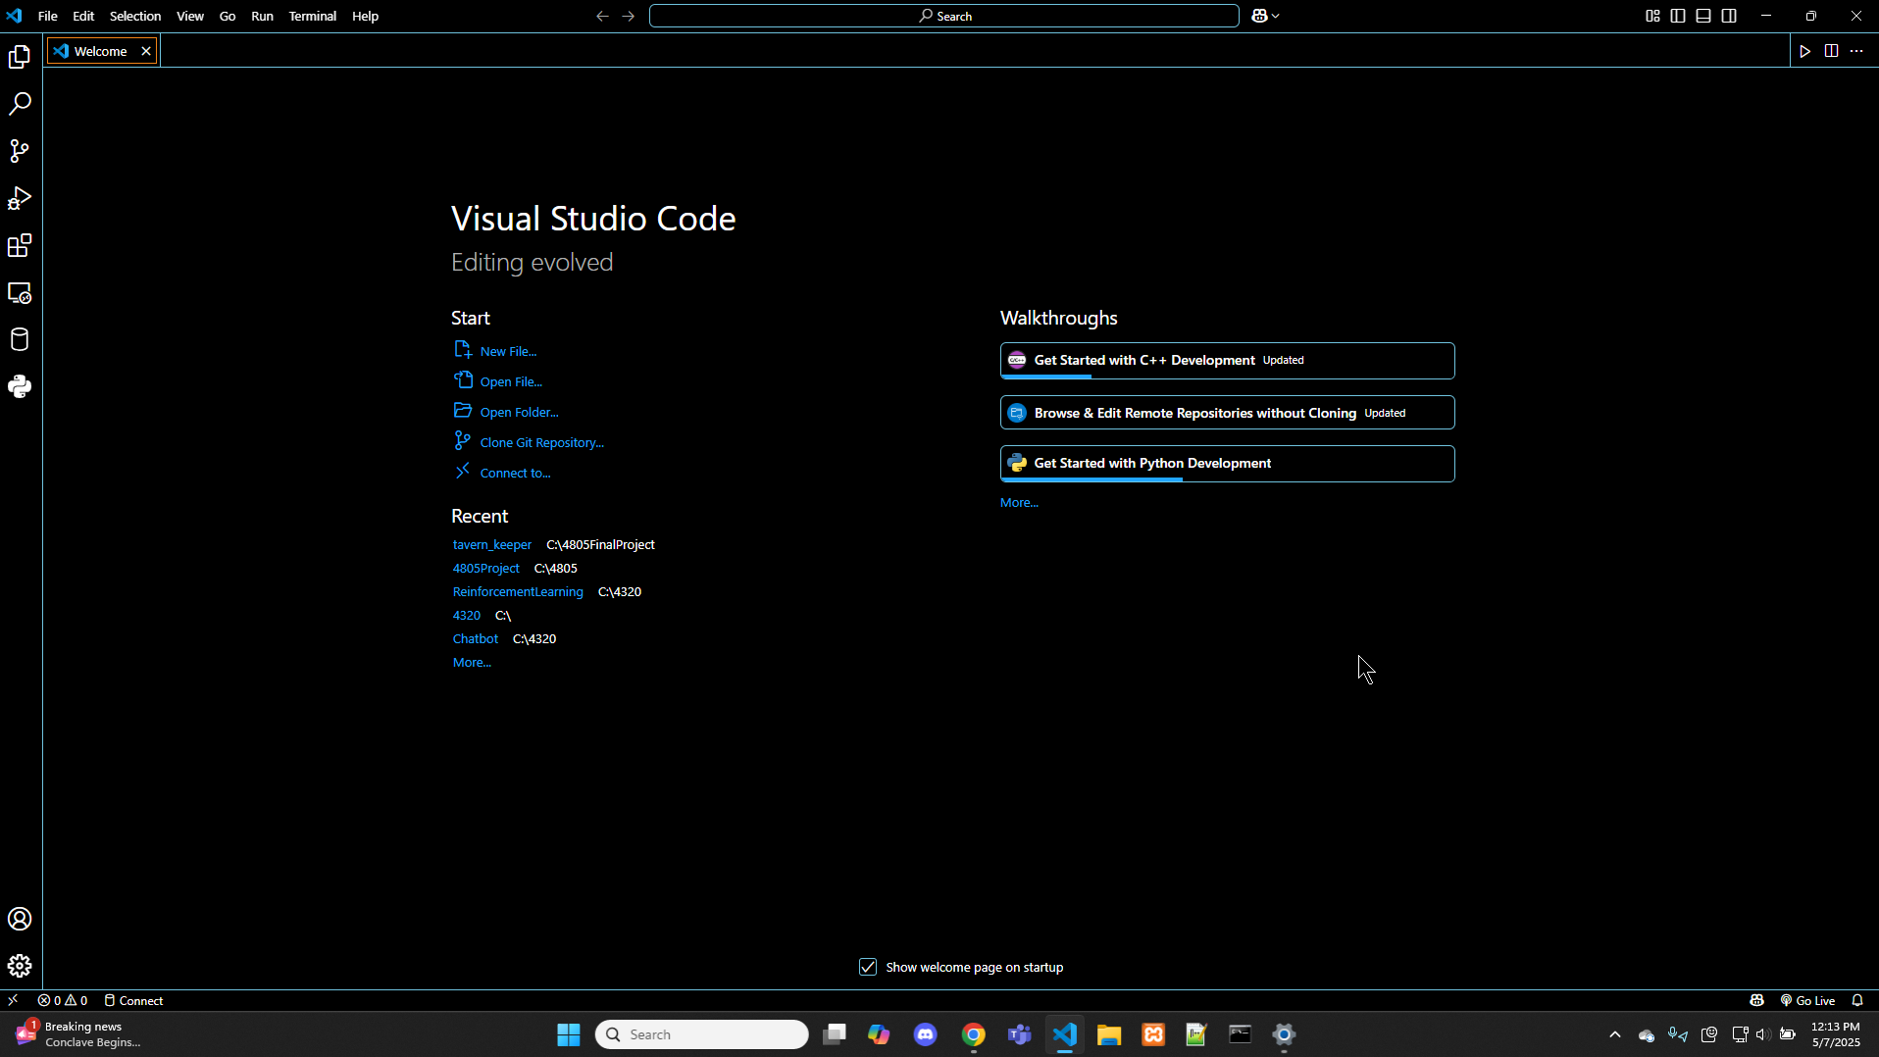
Getting Code into Visual Studio Code
2) Copy the code, navigate to Visual Studio Code and click Clone git Repository. Enter the code into the Dropdown menu

Slide 13
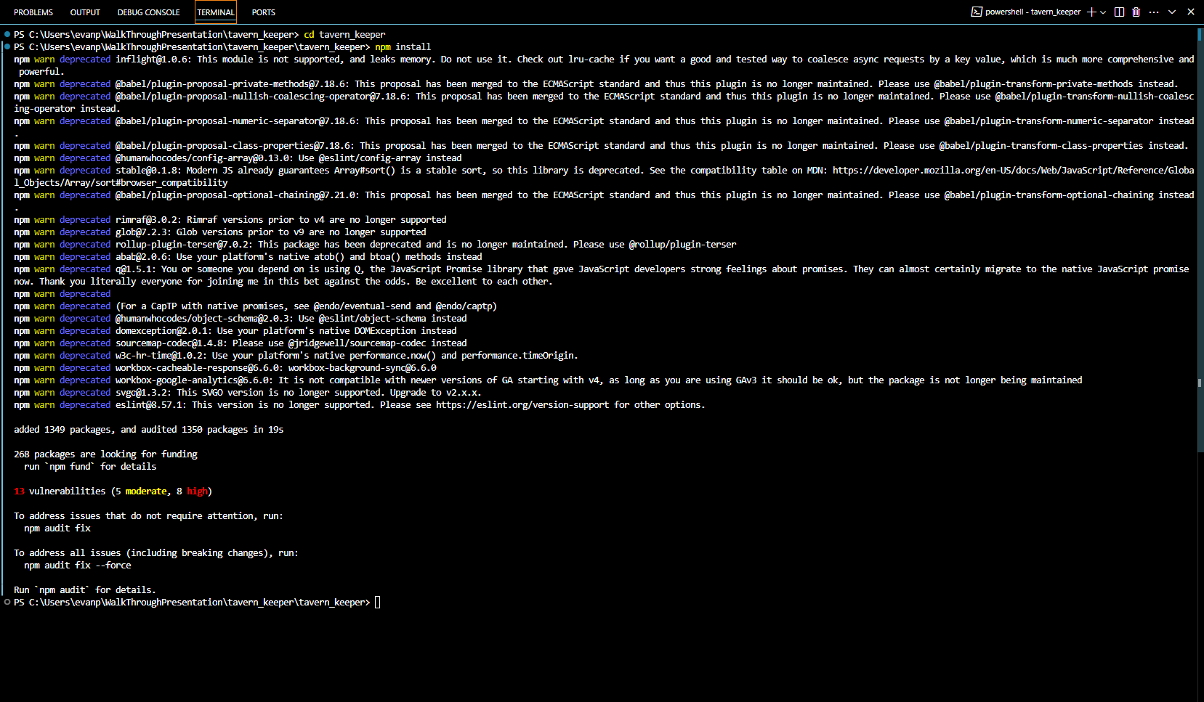
Installing necessary dependencies
3) After installing the code, open up a terminal in VS code and navigate up one directory by running cd tavern_keeper. Then run npm install to install the necessary dependencies.

Slide 14
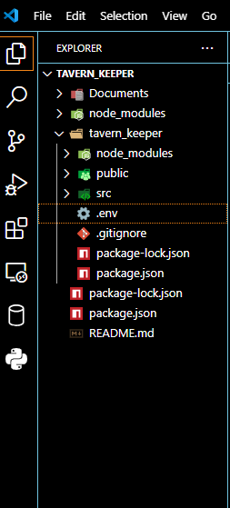
Adding env file
4) After installing the dependencies, users must create a .env file in their tavern_keeper folder. This file will hold our API Keys.

Slide 15
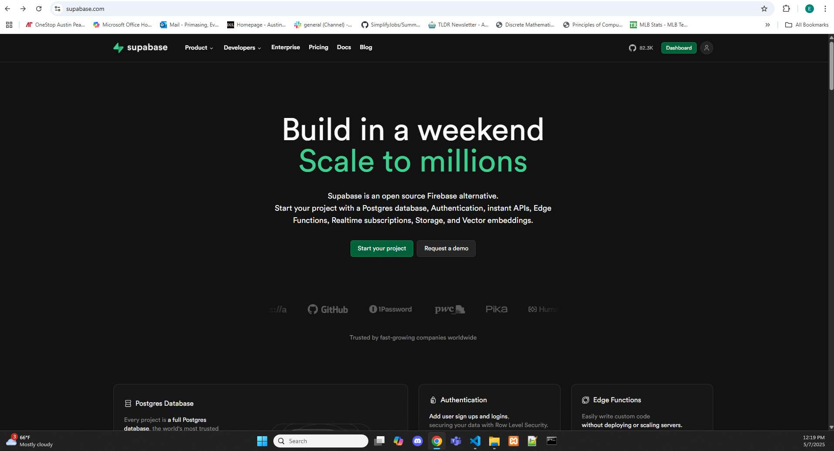
Create Supabase
Users will then navigate to Supabase.com and click on the green start your project button

Slide 16
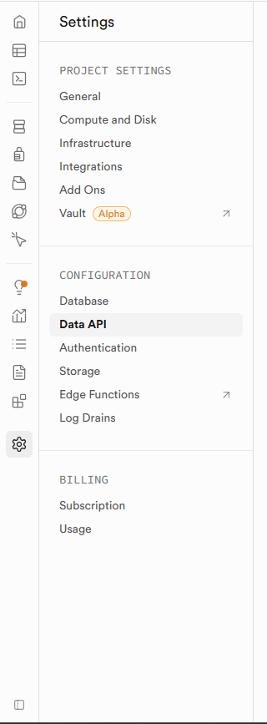
Getting API Keys
After creating a project and naming it, users will navigate to Data API, underneath the Project Settings tab on the left

Slide 17
API Keys
Users will then copy the items under Project URL and Project API Keys. After copying they will navigate back to their VS Code and the env file they just created. Then they will enter REACT_APP_SUPBASE_URL= and paste their URL and
REACT_APP_SUPABASE_KEY= and paste their Project API Keys

Slide 18
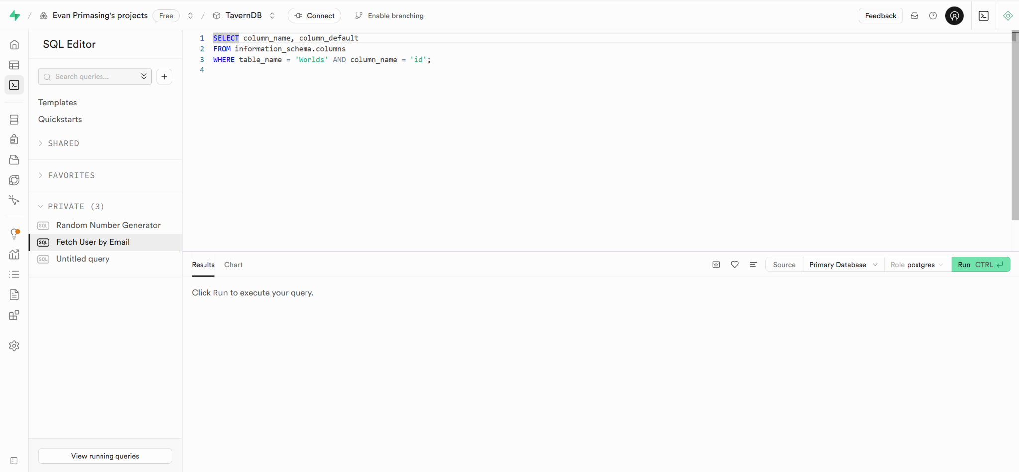
Creating Database
Navigate back to your project on supabase and navigate to the SQL Editor tab.

Slide 19
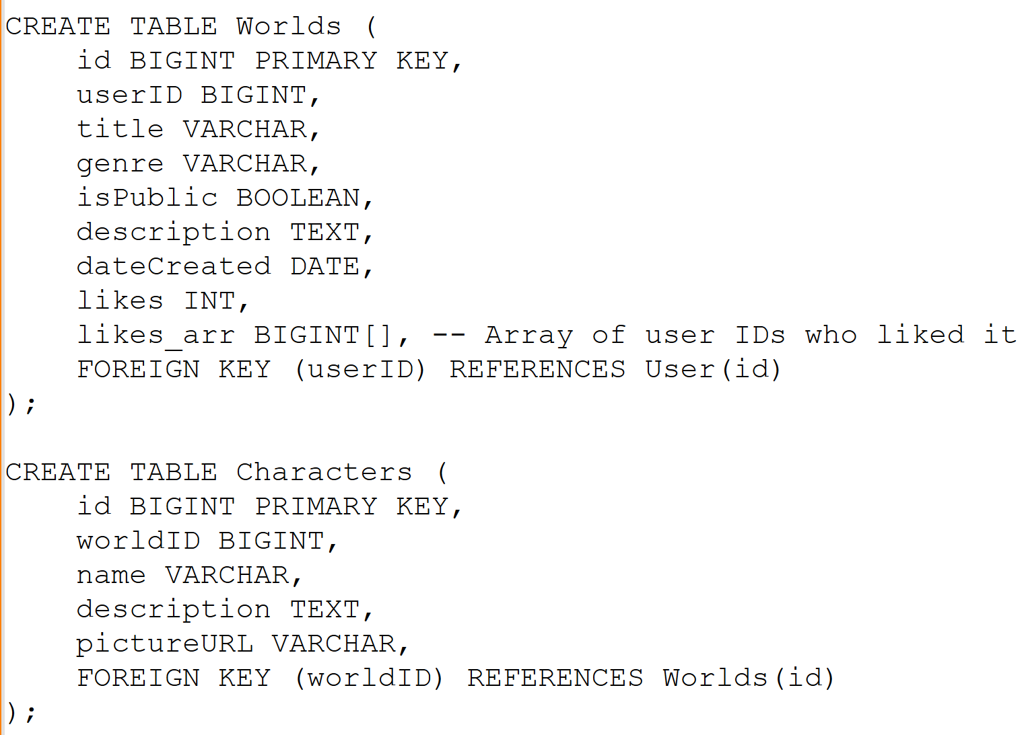
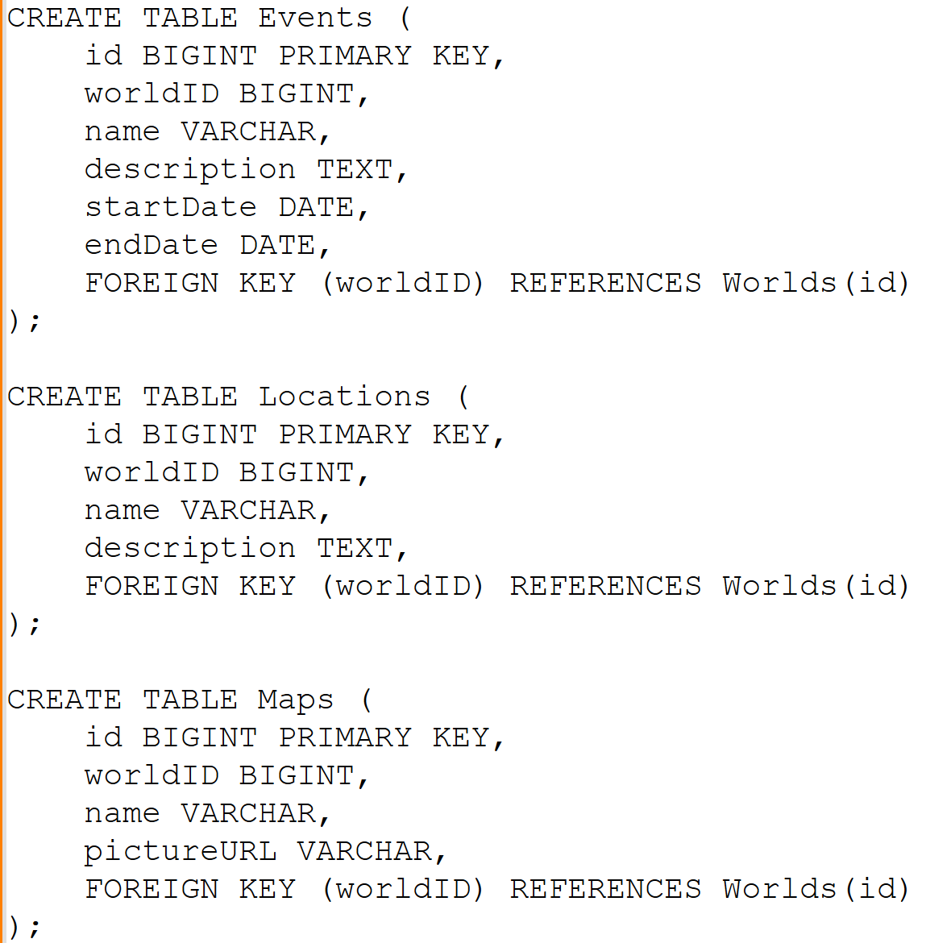
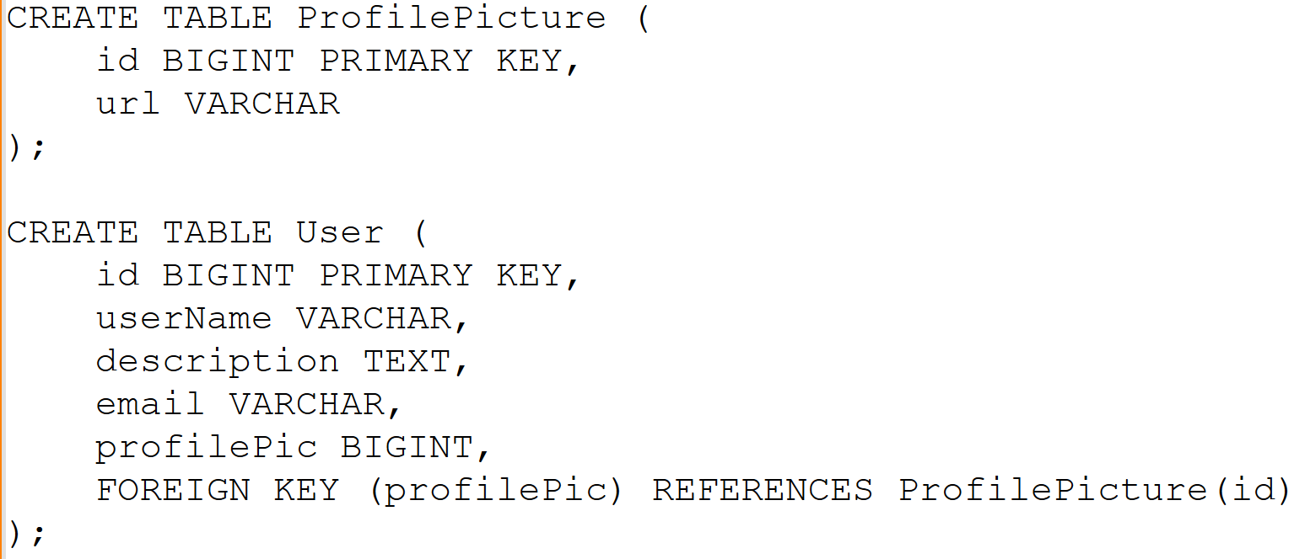
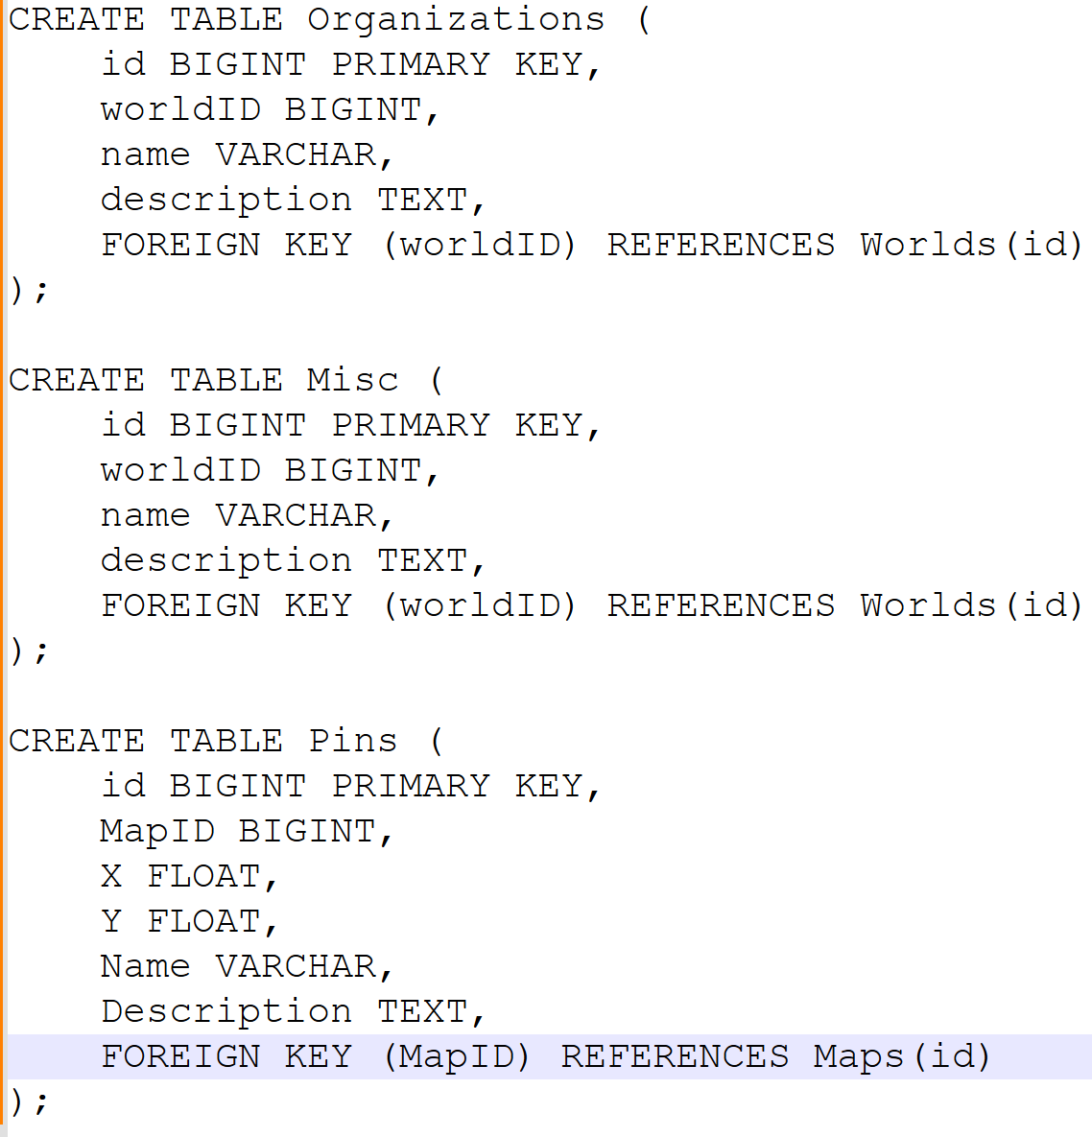
SQL
Once you have navigated to the SQL editor, enter this query to create all the necessary tables.

Slide 20
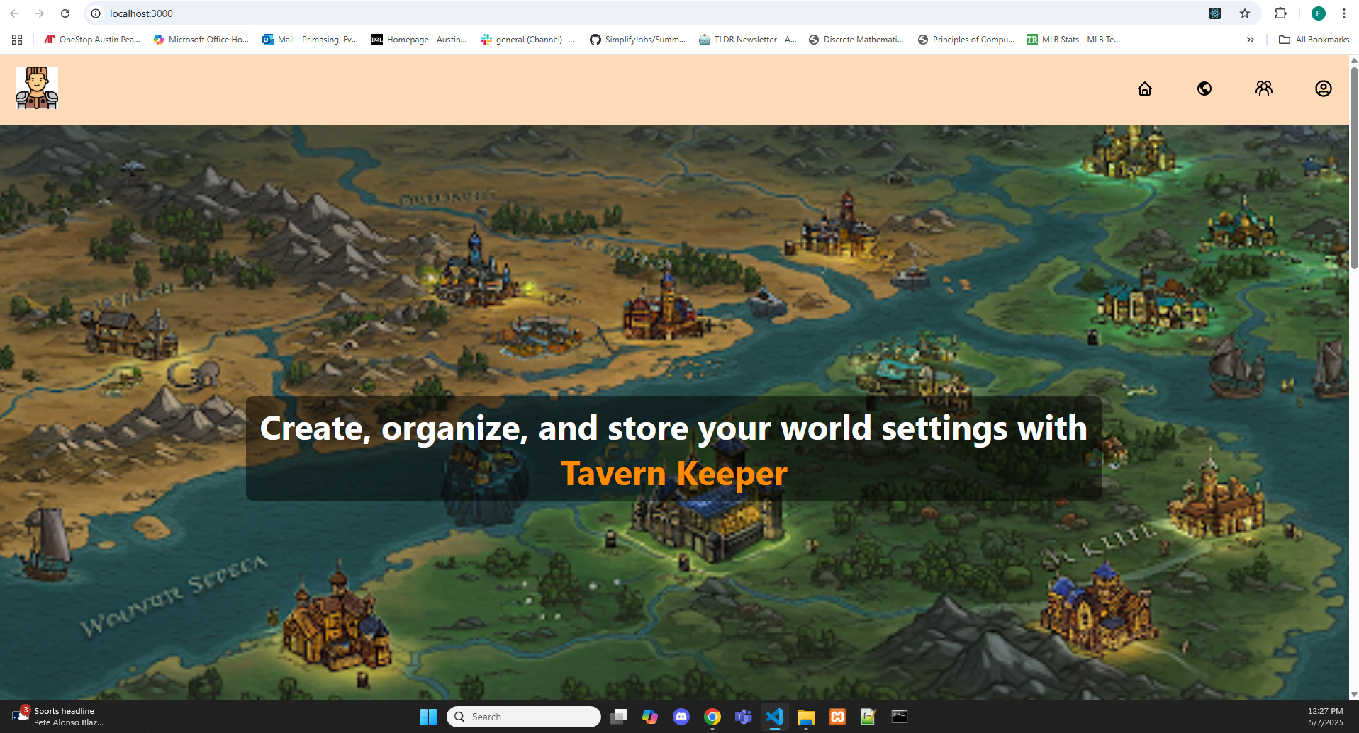
Running the application
Users will then be able to run the command npm start in their terminal, causing the application to be created in their default web browser under localhost:3000

Slide 21
Problems we faced
As we were all working with various different new technologies we faced many roadblocks throughout the way. However, we leaned on each other’s knowledge and were able to power through these problems successfully.
Connecting our website to a server was something that none of us had any experience with previously. Vercel, however, was extremely user friendly and offered documentation to help walk us through the process.
Connecting our database to our website was something that took us some time to master. None of us had worked with Supabase, or PostgreSQL, so this was a steep learning curve as well.

Slide 22
Problems part II
Implementing a responsive design, to ensure that our website was able to resize for all screen sizes, was not something that came easy to us. We had to learn how to utilize media queries to ensure that everything that we had was properly displaying on screens smaller than our laptops

Slide 23
Issues
Pin System - Scrapped due to time constraints
Profile Pictures - changed to file upload due to time constraints
Community Author Filter
Community View - minimal interaction
World Preview - information overview simplified due to time constraints
World Formatting - text over run bug
World Configuration - can not edit data on overview page

Slide 24
Questions
Thank you all for listening, are there any questions?

